Slide 1
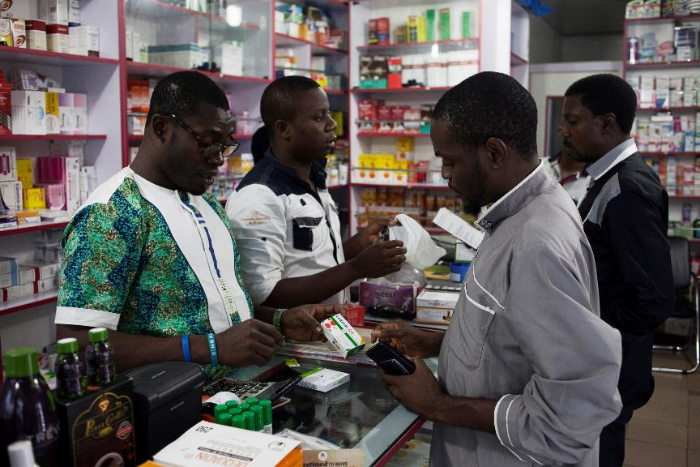

[COUNTRY, YEAR]
Module 4. Census field Operations

Slide 2
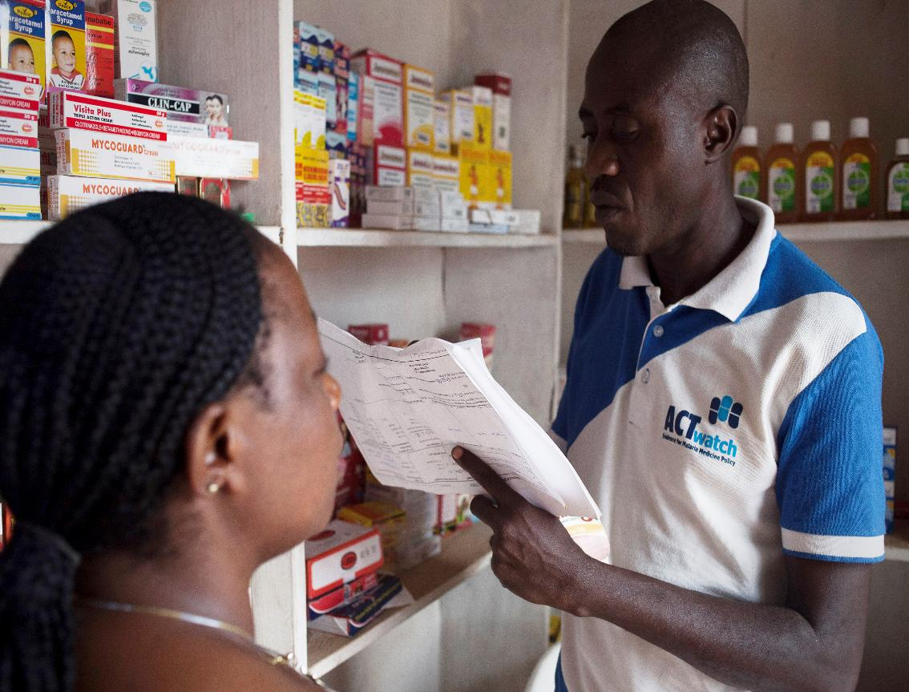
Agenda
Conducting an outlet survey
Outlet types
Identifying and sampling wholesalers
Introducing yourself and the study
Eligibility and consent
Flow chart activity
Logistics and responsibilities

Slide 3
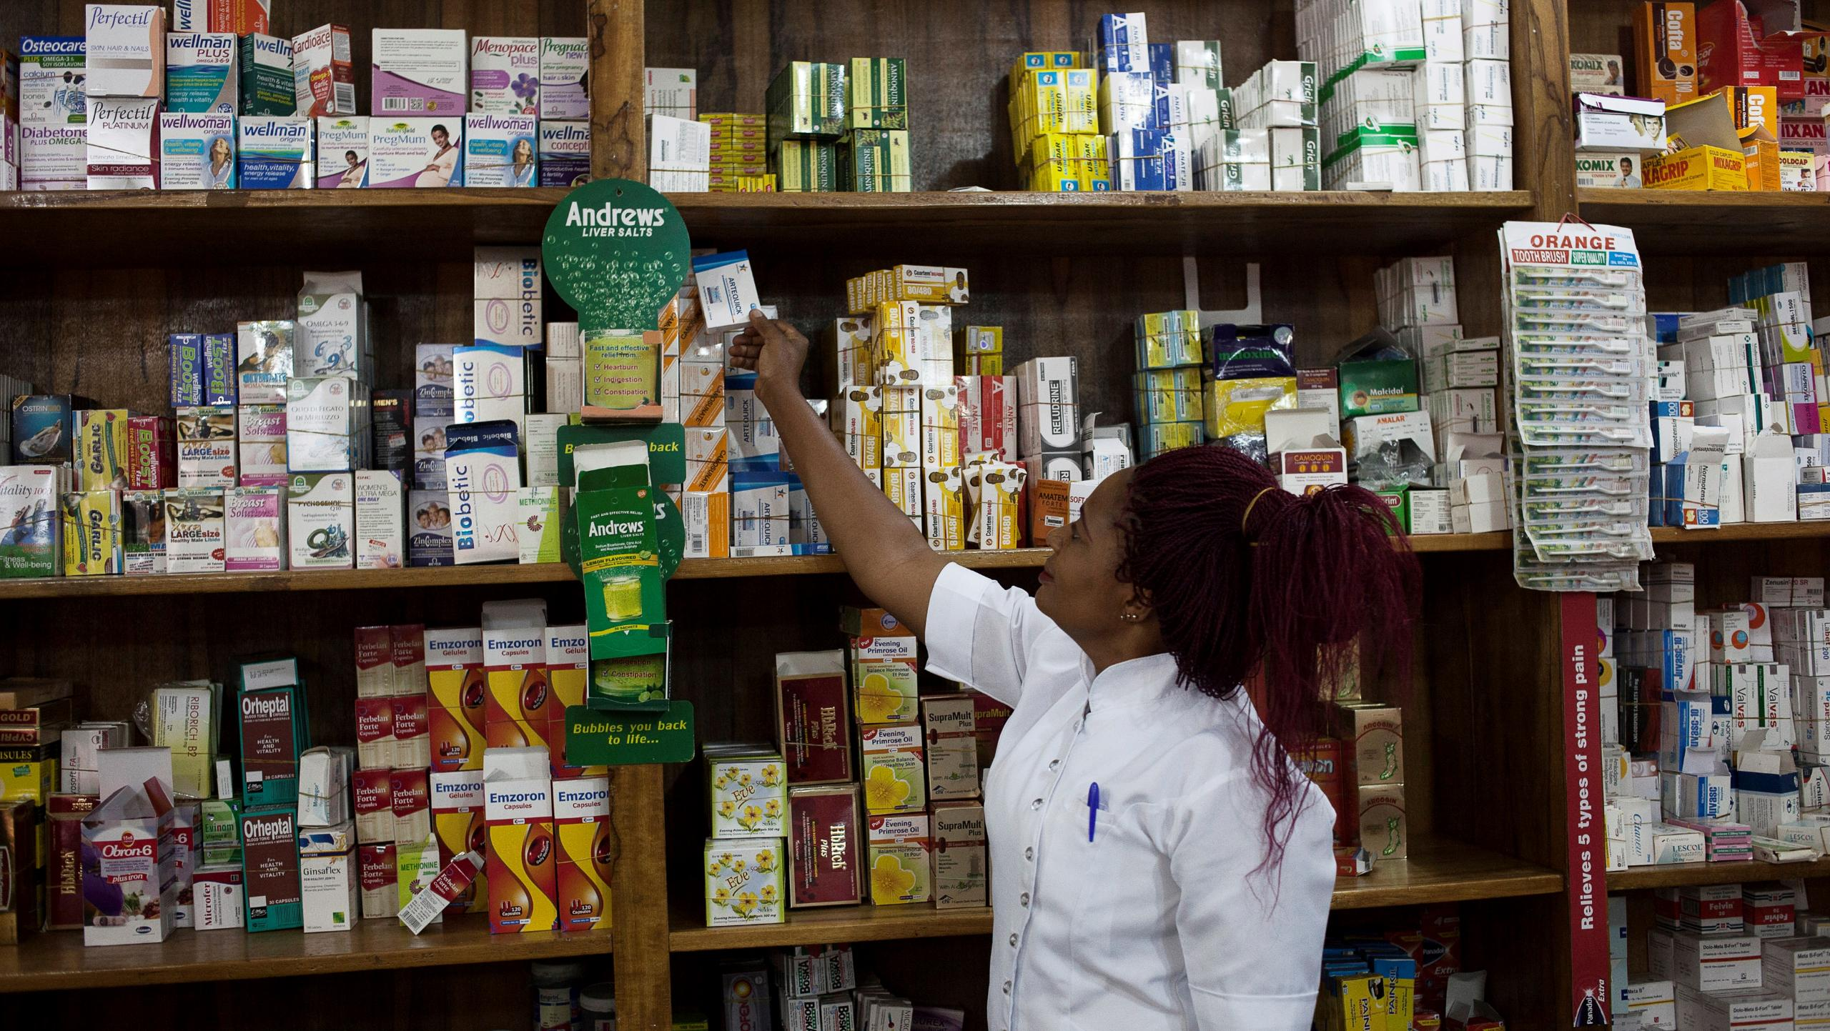
4.1 Conducting a census

Slide 4
TRAINER NOTES
Objective:
Ensure data collectors understand how to identify and screen all outlets with the potential to stock antimalarials or offer malaria diagnostics during a full area census.
Prompts & Answers:
What is a census in this study? ➔ A complete, door-to-door listing of all private sector outlets with potential to sell antimalarials or RDTs in selected wards/clusters.
Why doing a census? ➔ There is no a full list of eligible outlets. The census ensures completeness and coverage.
How is the census conducted? ➔ Use official outlet lists + snowball technique + walk all streets (not just main roads). ➔ Collect census info before eligibility screening or interviews. ➔ Record GPS, ward, and outlet details in SurveyCTO.

Slide 5
At the end of this session you should be able to:
Define a "census.”
Understand why it is necessary to register points of sale for the ACTwatch Lite project.
Have the necessary skills to identify outlets stocking anti-malarial drugs.
How to enter census information on the questionnaire.
Notes:
5

Slide 6
What is A census?
Note: update this slide with project country data and graphics.
A census is the systematic gathering and recording of specific information on ALL members of a given population/area.
The aim is to include and count every single member/household/outlet in a given area.
A common example is a population census.
The [Name of census organization] conducts population census in [country]. The most recent one was in [Year XXXX].
The map to the right shows population estimates [insert map with population estimates for sampled regions]

Slide 7
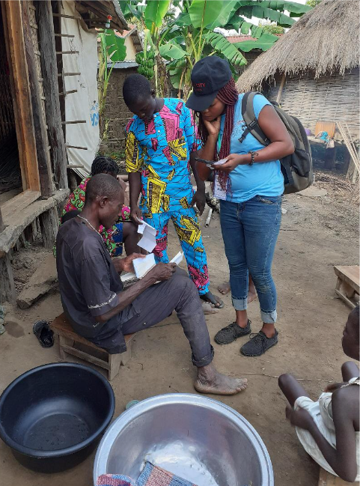
Where does census information come from?
Each household or unit is visited to participate and be counted.
Field agents go door-to-door to gather information.
Data is analyzed and statistics are published.

Slide 8
WHAT IS AN OUTLET CENSUS AS DEFINED FOR THIS STUDY?
The census we will undertake is similar to the population census, but you'll be visiting EVERY outlet in selected geographical areas.
For this study, you will identify the outlets with:
the potential to sell anti-malarial drugs, and
the potential to sell/perform diagnostic tests
Potential does not guarantee that the outlet has antimalarial drugs, but we want to know where all outlets with the potential to sell are.
We will cover what outlet types to include in the next section.

Slide 9
WHY DO A CENSUS FOR THIS STUDY?
To find out where all the anti-malarial drugs and tests are sold, and find out more about their availability, market share and prices...
...but we don't know the location of all the outlets with the potential to sell anti-malarials and the potential to sell/test them.

Slide 10
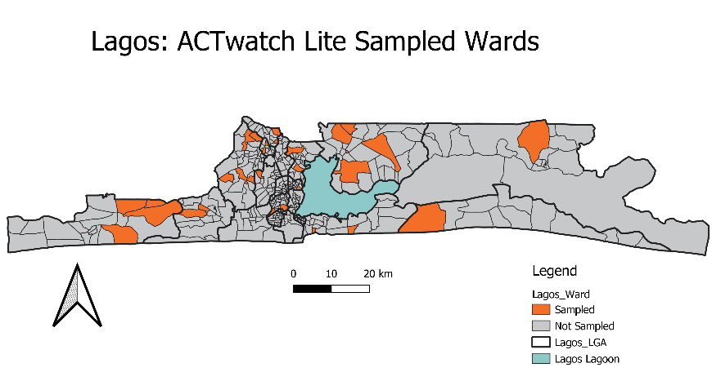
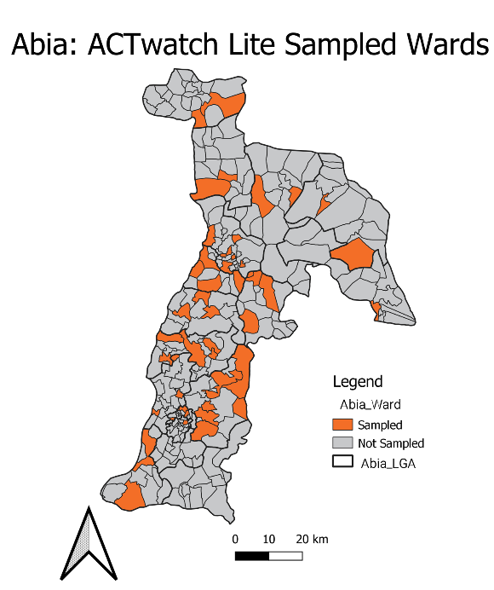
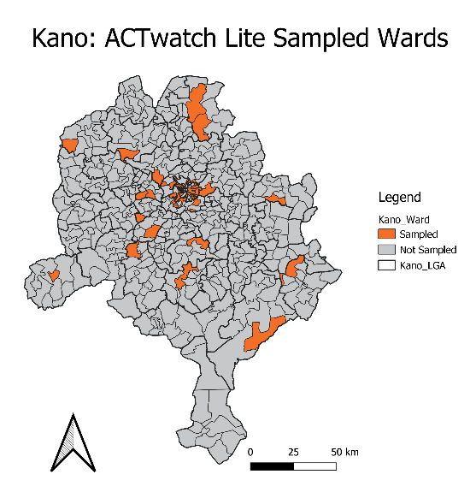
How do you conduct a census?
Note: This slide is provided with references from the ACTwatch Lite Nigeria study. Please update this slide with relevant country terminology and maps.
The census will be conducted in a representative sample across:
3 states: Kano, Abia, and Lagos
125 wards in total, spread across the 3 states
We also call these areas “clusters”
Notes:
Fix animation: 5 clicks total

Slide 11
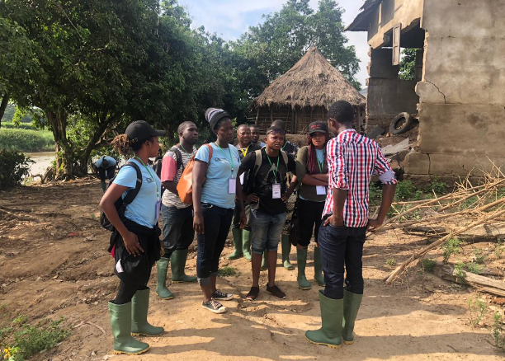
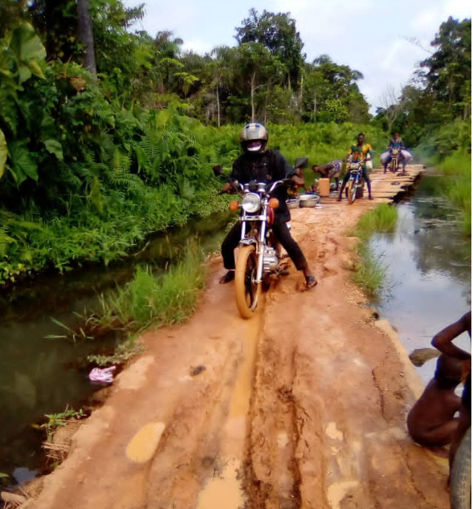
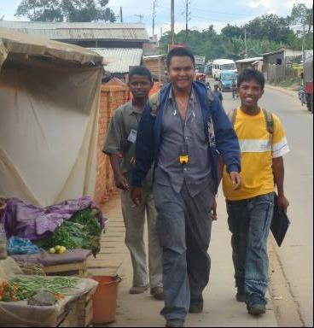
How do you conduct a census?
Each cluster will be visited by teams
All outlets with the potential to sell anti-malarials (or diagnostic services) will be visited.
To reach all outlets, the census is not only carried out along the main road! The whole [insert type of sampled region] should be included.
Notes:
Fix animation: 5 clicks total

Slide 12
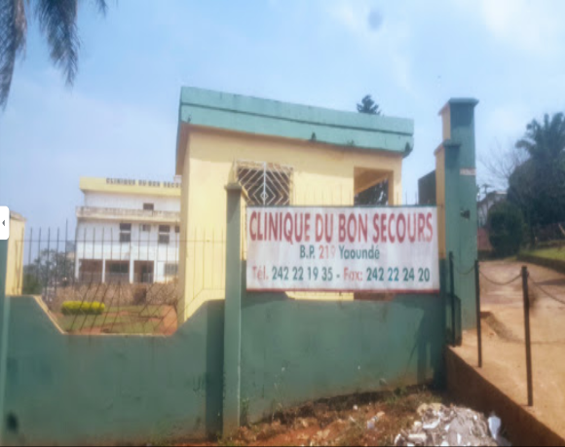
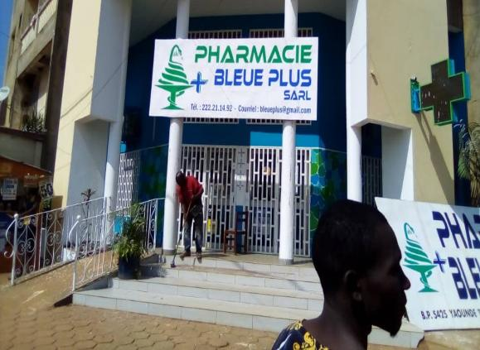
In each WArd the census will be carried out in 6 stages:
Obtain a list of approved establishments :
Registered private health establishments and approved pharmacies are listed in government registers.
Confirm this list with key people, such as the local malaria program or other health zone staff.
These lists will serve as a guide for the census. HOWEVER, these lists may not be complete or up to date. A complete census is still necessary.
Consult local & official managers to identify other outlets not on the list.
Informal pharmacies, stores, markets, etc.
Update this slide noting specifically who will do these steps based on your team structure e.g. team leaders will consult local authorities and obtain lists
Notes:
Fix animation: 5 clicks total

Slide 13
In each ward, the census will be carried out in 6 stages:
3. Ask your supervisor to establish the areas you'll need to visit
Stay within the geographical limits of your zone.
You will need to gather information on:
The boundaries of the area using the map you will be given
Mark all outlets visited on the map to ensure completeness
Start by walking!
Visit the first point of sale, take stock and conduct a survey
Use the snowball technique: ask the providers or outlet managers you are investigating to identify other outlets selling anti-malarial drugs/tests
Go to the next point of sale
It sounds easy, but there can be complications...
Outlets may only be open at certain times, providers only available at certain times, etc.
Notes:
Fix animation: 5 clicks total

Slide 14
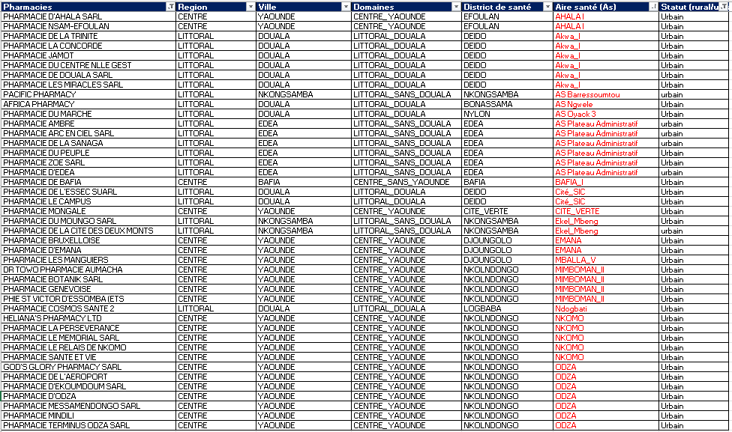
EXAMPLE PHARMACY LISTING FROM CAMEROON
[INSERT YOUR LISTING(S) IF AVAILABLE]

Slide 15
CENSUS INFORMATION
Before entering the outlet, capture information on the outlet location:
Record the state, LGA, locality/ ward
Capture GPS points
Outlet ID is automatically generated by SurveyCTO and will be entered on the consent form.
Even if an outlet refuses to participate, or is unavailable, the census information should be collected in the form.
Note: Update geographical terminology based on your project country.

Slide 16
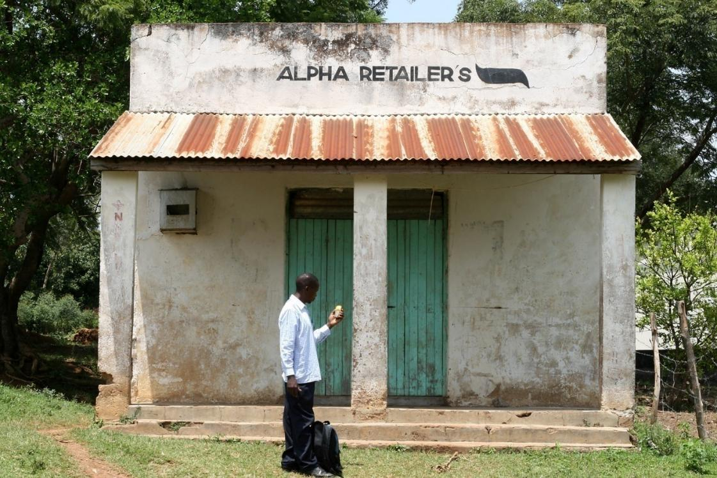
WHAT DO I DO IF THE OUTLET IS CLOSED?
You'll try to make up to two more passes to investigate these outlets.
In what other situations would you have to revisit this outlet?
Interview interrupted
Eligible provider not available / Time not convenient
You'll have to manage re-visits in the same way as you progress with the census.
Notes:
Fix animation: 5 clicks total

Slide 17
BOOSTER AREAS
In addition to the points identified in the selected wards, other health facilities and pharmacies may be visited.
We will monitor how many pharmacies/ health facilities are included in the study and may extend the collection to some nearby outlets.
The aim is to increase the number of health facilities and pharmacies available for analysis.
What other areas should we visit?
Supervisors will be provided with a list of additional outlets located in or near the selected areas
Update this slide based on the protocol for your study. In some contexts, booster sample areas will not be used and this content can be removed

Slide 18
You should now be able to:
Define a “census.”
Understand why it is necessary to identify points of sale for the ACTwatch Lite project.
Have the necessary skills to identify outlets stocking anti-malarial drugs.
How to enter census information on the questionnaire.
Notes:
18

Slide 19

ACTwatch Lite [Country, Year]
Thank you for your attention!
Any questions?

Slide 20
4.2 Outlet types

Slide 21
TRAINER NOTES
Objective:
Help data collectors correctly identify, classify, and distinguish eligible retail outlets for inclusion, and recognize which outlet types should be excluded.
Prompts & Answers:
What is a retail outlet? ➔ Any place (fixed or mobile) where antimalarials or RDTs are sold or provided to the public.
Which outlets are included? ➔ Private clinics, private pharmacies, PPMVs, labs, drug shops, market stalls, informal vendors.
Which outlets are excluded? ➔ Public health facilities, specialty clinics (e.g. dental, eye), traditional healers, veterinarians, kiosks selling only food/products.
What about multiple pharmacies in one hospital? ➔ Record as one outlet, but audit each pharmacy/dispensary separately

Slide 22
At the end of this presentation you should be able to:
Identify the different types of retail outlets to be visited during this study.
Correctly classify retail outlets.
Understand why certain retail outlets should be excluded from the study.
Understand that the study will also include wholesalers located in the selected communes.
Notes:
22

Slide 23



Part I
Retail outlets
Market survey of retail outlets providing anti-malarial drugs and/or RDTs and malaria diagnostic testing services to the population of [your country].
Market survey of wholesalers of antimalarial products and wholesalers of RDTs serving the outlets included in the market survey of retail outlets.
Private clinics, labs, hospitals
Private pharmacies , Drug shops
Informal outlets

Slide 24
Identification of sales outlet types
What is an outlet?
An outlet is defined as any place where merchandise is sold or made available to an individual.
Outlets are not only fixed points of sale but can also include mobile points of sale.

Slide 25
What types of outlets sell anti-malarial drugs?
What types of outlets do you think offer antimalarial drugs or diagnostic services in [your country]?
Do these types of outlets vary between rural and urban areas?
What other differences can we expect?
Notes:
Animation needed here

Slide 26
Retail outlets include:
Clinic or hospital
Laboratory
Community pharmacy or dispensary
PPMV - Patent & Proprietary Medicine Vendors
Retail shop
Street vendor
Other
[REPLACE WITH OUTLET TYPES FOR YOUR PROJECT COUNTRY]

Slide 27
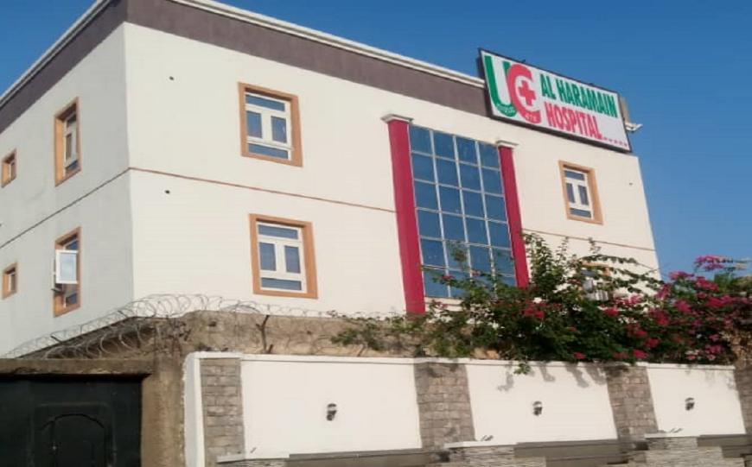
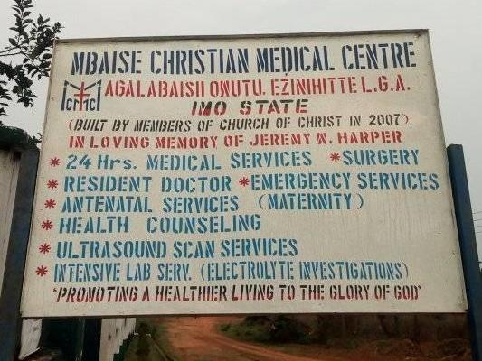
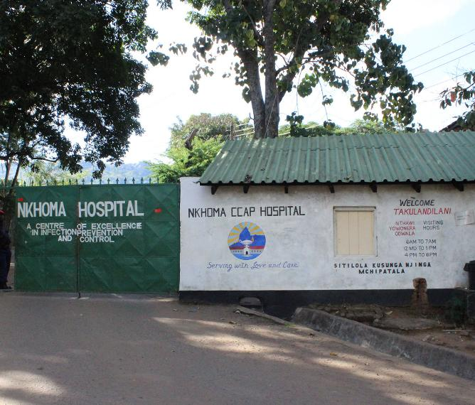
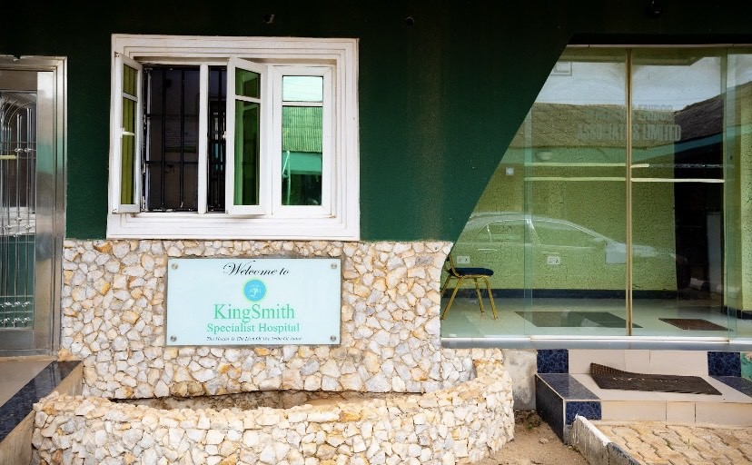
Private health Facilities
Not-for-profit
For profit

Slide 28
Multiple pharmacies in a hospital complex
If a private hospital complex has several pharmacies, they will all be considered as a single outlet.
This means that you only need to complete one questionnaire in the main pharmacy.
Nevertheless, separate drug audit and RDT forms must be completed for each dispensary in addition to those for the main pharmacy.
For each dispensary and pharmacy, interview the person responsible for managing antimalarials and RDTs to complete the audit sheet.
Notes:
Each dispensary and pharmacy has a designated person responsible for managing antimalarial and RDT stocks. This person should be approached by the data collector to complete the audit sheet. Instruction is added as fourth bullet in the slide.

Slide 29
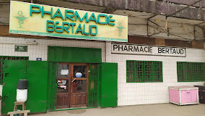
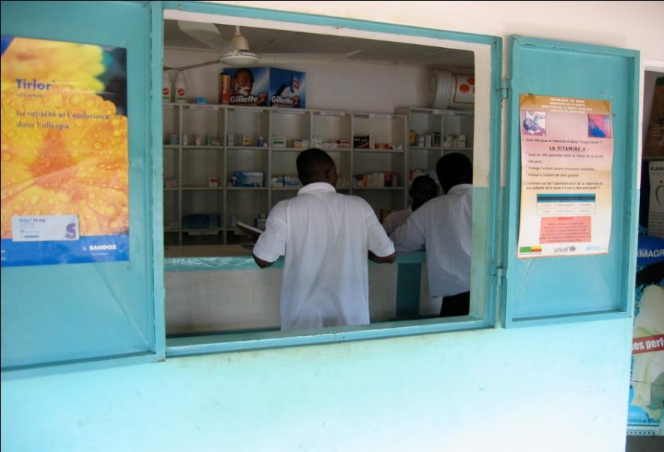
PHARMACY
Training facilitators:
Please adapt this slide for your country. Add country-specific photos where possible.

Slide 30
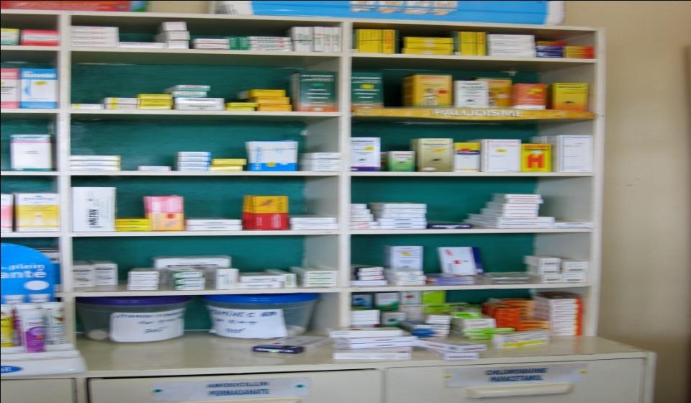
DRUG STORE
Training facilitators:
Please adapt this slide for your country. Add country-specific photos where possible.

Slide 31
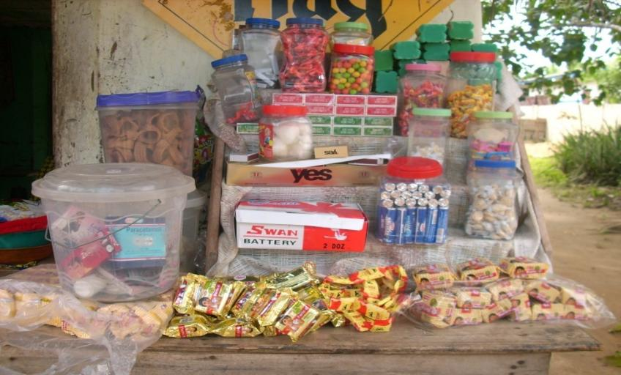
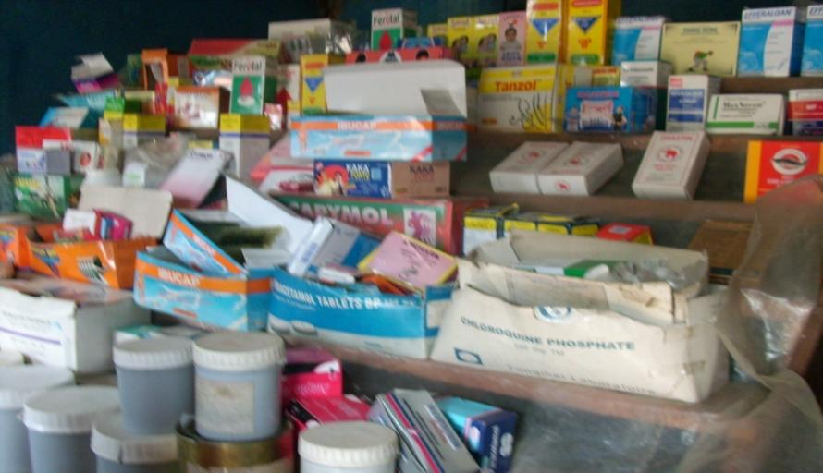
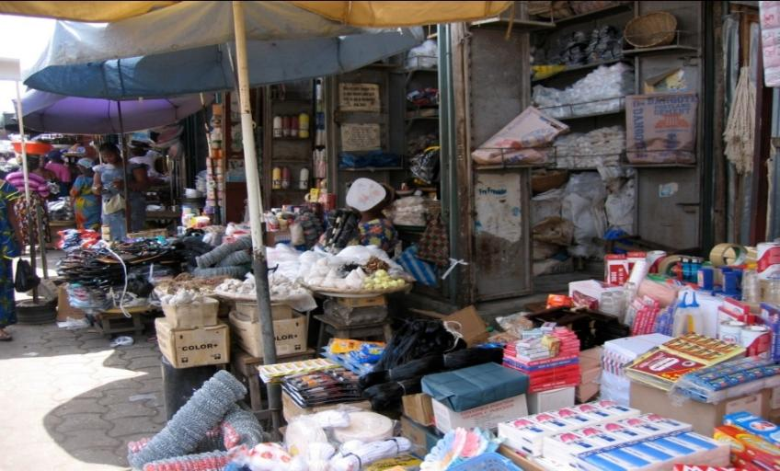
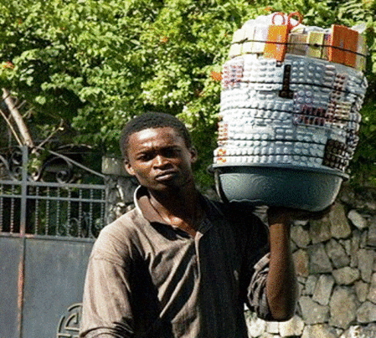
INFORMAL SALES OUTLETS
Off-market display
Store
Training facilitators:
Please adapt this slide for your country. Add country-specific photos where possible
Market display
Street vendor

Slide 32
What outlets do we visit?
Visit:
Clinic or hospital
Laboratory
Community pharmacy or
dispensary
PPMV - Patent & Proprietary Medicine Vendors
Retail shop
Street vendor
Do not visit:
Public health center, Specialty health center (dentist, ophthalmologist, ENT)
HIV and syphilis screening center.
Stalls, kiosks and boutiques selling only perishable products
Outlets for medicinal and traditional plants
Veterinarians
Hardware stores
Salons (men's and women's hair salons)
Vegetable, meat and miscellaneous salesmen ...
Any point of sale not listed on your questionnaire
Note: replace outlet types with those relevant to your project country.

Slide 33
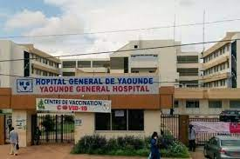
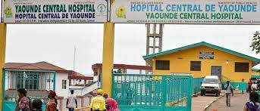
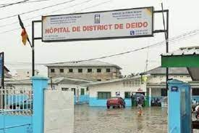
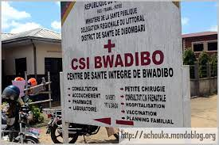
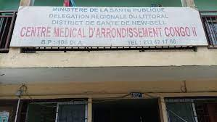
SALES OUTLETS TO BE EXCLUDED FROM THIS STUDY: PUBLIC OUTLETS
HG
HC
These examples are from [your country].
What are public facilities you will not visit for this study?
Training facilitators:
Please adapt this slide for your country. Add country-specific photos where possible
HD
CSI
CMA

Slide 34
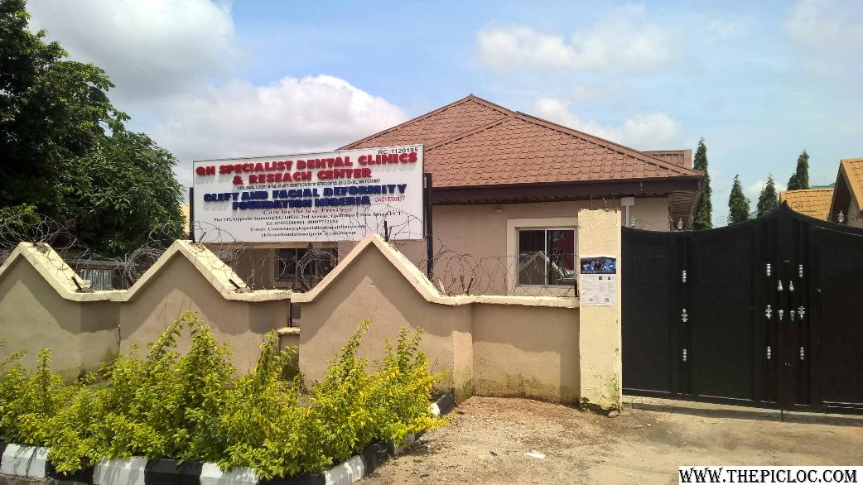
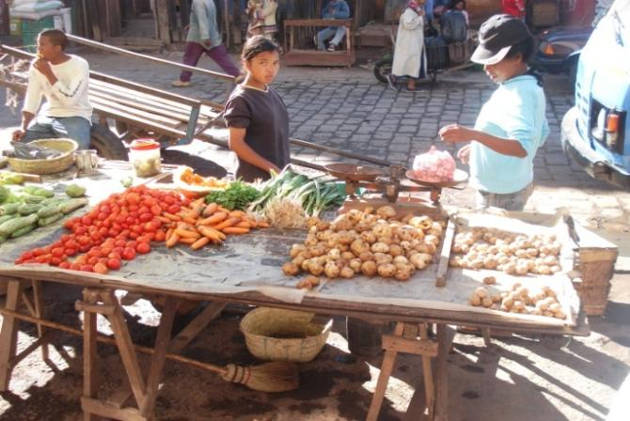
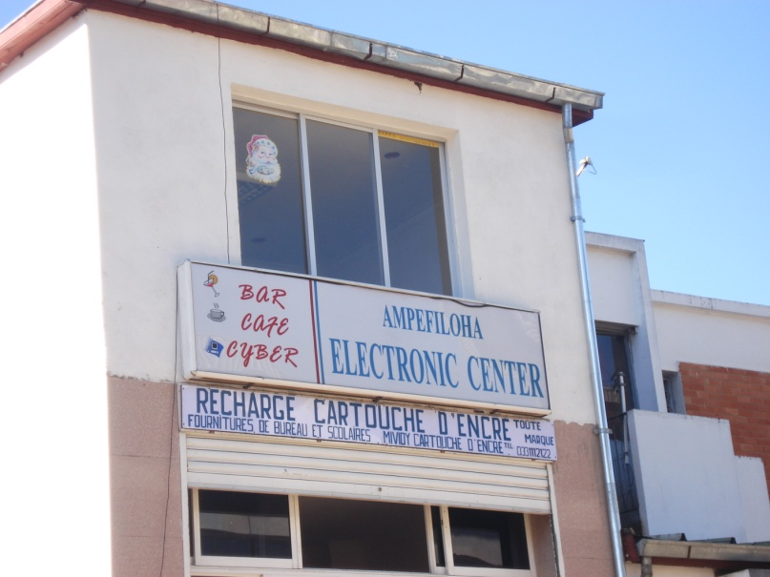
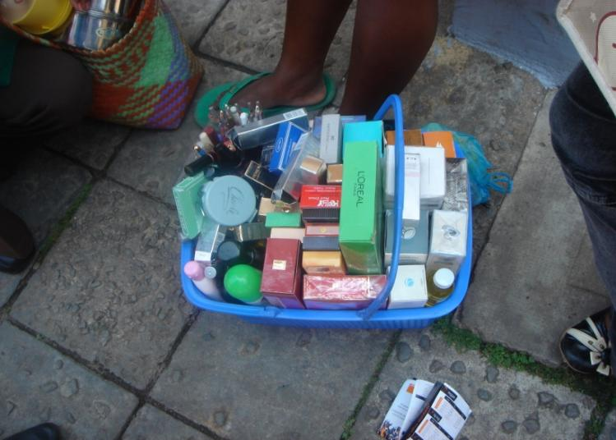
POINTS OF SALE TO EXCLUDE FROM THIS STUDY: OTHER TYPES
Notes:
34

Slide 35
Part II
Wholesalers
Market survey of retail outlets providing anti-malarial drugs and/or RDTs and malaria diagnostic testing services to the population of [your country].
Market survey of wholesalers of antimalarial products and wholesalers of RDTs serving the outlets included in the market survey of retail outlets.
A
Training facilitators:
Please adapt this slide for your country. Add country-specific photos where possible
Private clinics, labs, hospitals
Private pharmacies
PPMVs
Informal outlets
B

Slide 36
What types of wholesale outlets are there for anti-malarials and RDTs?
What types of outlets do you think offer anti-malarial drugs or wholesale diagnostic services in [your country]?
Do these types of outlets vary between rural and urban areas?
What other differences can we expect?
Notes:
Animation needed here

Slide 37
Wholesalers to visit include:
Distributor
Pharmacy wholesale
Other shops that sell to other outlets
Others?

Slide 38
Categories of wholesalers to be visited during this study
All the wholesalers you will visit during this study fall into one of the following main categories:
Wholesaler / importer only
Pharmacies and wholesale depots
Informal wholesale outlets
Wholesalers will be sampled on the basic information gathered from retail outlets.
We'll come back to this in more detail later!

Slide 39
YOU SHOULD NOW BE ABLE TO:
Identify the different types of retail outlets to be visited during this study.
Correctly classify retail outlets.
Understand why certain retail outlets should be excluded from the study.
To understand that the study will also include wholesalers located in the selected communes.

Slide 40

ACTwatch Lite [Country, Year]
Thank you for your attention!
Any questions?

Slide 41
4.3 Wholesale sampling

Slide 42
TRAINER NOTES
Objective:
Train data collectors to understand how wholesalers are identified, selected, and sampled during fieldwork using real-time data from the retail survey.
Prompts & Answers:
How are wholesalers identified? ➔ By asking retail outlets for the names and contact info of their recent antimalarial and RDT suppliers.
What information should be recorded from the retailer? ➔ Supplier name, type, location, phone number (if available).
How are wholesalers selected for interview? ➔ The remote research team monitors submissions and selects eligible wholesalers daily. ➔ Selected wholesalers are shared with field team supervisors for follow-up
Do data collector decide who to visit? ➔ No. Selection is centrally managed to avoid duplication and ensure coverage.

Slide 43
IDENTIFYING SUPPLIERS/ WHOLESALERS:
A
The market survey of retail outlets and the survey of wholesalers will take place simultaneously in the field.
Information gathered from retail outlets will be used to identify wholesalers.
When interviewing retailers, we will gather information on the suppliers the outlet has used over the past three months.
We will only include wholesalers found within the selected study areas (wards)
Training facilitators:
Please adapt this slide for your country. Add country-specific photos where possible
Private clinics, labs, hospitals
Private pharmacies
PPMVs
Informal outlets
B

Slide 44
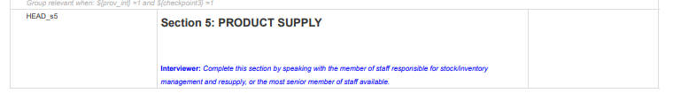
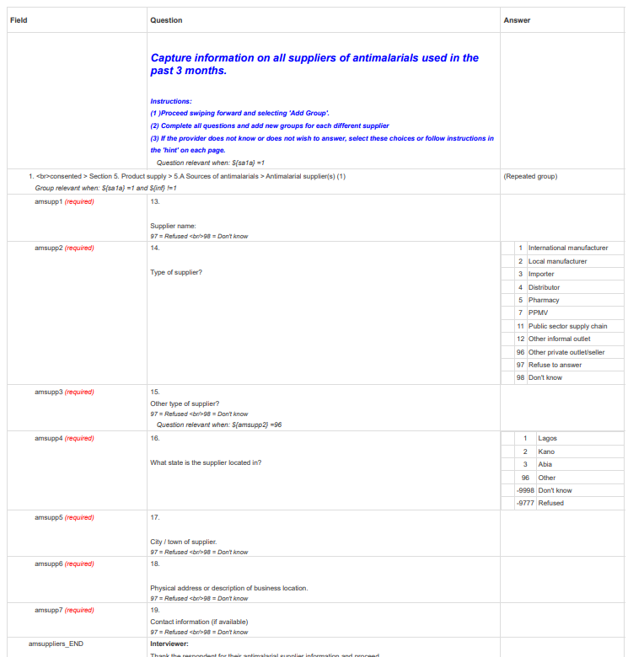
SUPPLIER INFORMATION
We will ask each outlet who their suppliers are.
We will also ask if they can share details on their suppliers:
Company name
Type of supplier
Location (state, city, etc.)
Contact information
This data will be checked throughout data collection and shared with field team supervisors to guide wholesaler/ supplier interviews.
REPLACE WITH SCREENSHOT OF YOUR QUESTIONNAIRE PRODUCT SUPPLIERS SECTION

Slide 45
SUPPLIER INFORMATION
It is essential to collect accurate and detailed information in order to:
Identify unique wholesalers;
Sample wholesalers for inclusion in the study, and to;
Share wholesaler information with field team supervisors in real time.
REPLACE WITH SCREENSHOT OF YOUR QUESTIONNAIRE PRODUCT SUPPLIERS SECTION

Slide 46
WHOLESALE SAMPLING
During collection, a remote research team will review the data submitted on a daily basis, and maintain an up-to-date list of eligible wholesalers located in the study communes.
The remote research team will select wholesalers to visit and share this information with field team supervisors via email (and WhatsApp?).

Slide 47
4.4 Eligibility and consent

Slide 48
TRAINER NOTES
Objective: Train data collectors to determine if an outlet is eligible for the survey and how to properly introduce the study and obtain oral consent from providers.
Prompts & Answers:
When is an outlet eligible? ➔ If it has antimalarials in stock today OR had any in the last 3 months. ➔ If it offers malaria testing today OR did so in the last 3 months.
How to introduce yourself and the study? ➔ Use the script in the questionnaire: “Hello, my name is [X]. I work for [organization]…” ➔ Emphasize voluntary participation and confidentiality.
How is consent obtained? ➔ Oral consent (not written) is recorded by the data collector. ➔ Share the information sheet and offer to read it aloud if needed.
What if the provider refuses or is unavailable? ➔ Make up to 2 return visits. ➔ Record result in the form and inform supervisor if needed.

Slide 49
At the end of this presentation you should be able to:
How to present yourself and the study to the service provider.
Determine whether an outlet meets the required conditions.
Determine whether a service provider wishes to be interviewed.
Obtain provider consent.
Overcome obstacles to obtaining consent.
Notes:
49

Slide 50
INTRODUCE YOURSELF AND THE STUDY

Slide 51
This is the first time you've spoken to a potential respondent. Introduce yourself.
INTRODUCE YOURSELF AND THE STUDY
Interviewer prompt:
Hello, my name is {____}. I work for [External research agency, if relevant] and [your organization name]. We are conducting a study on the availability of antimalarial drugs and malaria screening services in outlet/ businesses like yours in [your country]. The results will help us improve the availability of appropriate drugs and treatment of malaria in [your country].
I would like to ask you some questions to see if you can participate in this study. This is a study and you are under no obligation to participate, as it is completely voluntary. I would also like to assure you that the answers you give will remain confidential. We won't pass on your details to the authorities, and you won't have to fear any reprisals.

Slide 52
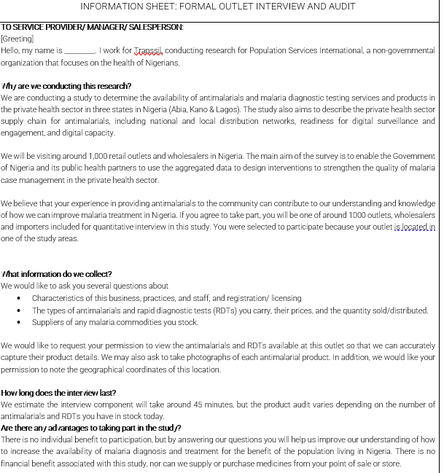
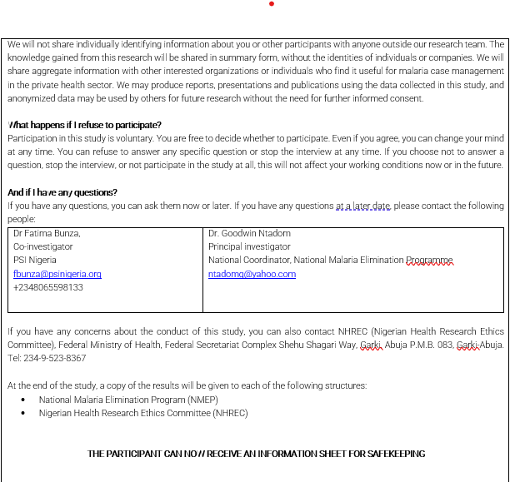
Share the information sheet with the respondent and offer to read it if they wish.
INTRODUCE YOURSELF AND THE STUDY
REPLACE WITH SCREENSHOT OF YOUR STUDY INFORMATION SHEET
Note copies of the information sheets should be printed for each trainee to read and review
Please take a moment to read the study information sheet provided to you

Slide 53
FREQUENTLY ASKED QUESTIONS AND SUGGESTED RESPONSE:
“What information do you need from me?”
We would like to ask you a number of questions about:
The types of antimalarial drugs and rapid diagnostic tests (RDTs) you carry, their prices, and the quantity sold/distributed;
Suppliers of antimalarials and RDTs, if you stock RDTs;
Company characteristics, with a focus on the company's access to and use of digital technologies;
The characteristics of the people who work at your facility; and
Your knowledge of malaria treatment in [your country].
We would like to request your permission to view the antimalarials and RDTs available at this outlet so that we can accurately capture their product details. In addition, we would like your permission to note the geographical coordinates of this location.

Slide 54
FREQUENTLY ASKED QUESTIONS AND SUGGESTED RESPONSE:
“How long does the interview last?”
The interview with you should take around 45 minutes, depending on how many antimalarials and RDTs you have in stock today.
“Why do I have to take part?”
You can help us better understand how to increase the availability of malaria treatment for all local residents.

Slide 55
FREQUENTLY ASKED QUESTIONS AND SUGGESTED RESPONSE:
“Who will see the information I give you?”
Any identifying information is private and confidential and will not be shared with anyone. Only the remote research team will have access to it. Other anonymous data may be shared externally, but all identifying data (including names, outlet names, GPS coordinates, etc.) will be removed before it is shared.
“What if I don't participate?”
Participation is voluntary. You are free to decide whether or not to participate. You can stop the interview at any time. There are no negative consequences from not participating.
“May I ask a question?”
I can answer it now, or you can contact the remote research team now or anytime later.
If you have any questions, you can contact the members of the IRB, NHREC, using the contact information provided on the information sheet.

Slide 56
KEY POINTS TO KEEP IN MIND
Advocacy plan before the survey
Work with [external research agency] and [your organization name]
Share letter of information to pharmacists via Pharmacy council, or other private health worker associations
Field team supervisors
Face to face visit to the health officer of the locality, Whatsapp group or signed authorization?
Appointment with pharmacies the day before?
Inform coordination team ASAP in case of refusal (particularly for formal outlet)
Data collectors
Emphasize confidentiality and anonymity of responses
Do not be invasive (only 1 or 2 people enter outlet to present the purpose of the visit)
Appropriate dress
Stay professional, be concise
Always work in a pair (This is very important in pharmacies! So many products!)
Avoid too much mention about the government agency involvement (this is an independent survey)

Slide 57
Simulation exercise
You will work in pairs. Each group will be given 2 types of outlets (pharmacy and private clinic).You'll take turns playing the role of interviewer and provider. Each person must play the role of the interviewer at least once.
For the person playing the role of interviewer:
First, introduce yourself, using the standard script on the questionnaire.
Respond patiently to any questions the service provider may have.
Once you've introduced yourself, and if the provider is willing, ask the screening questions to determine eligibility.
Proceed to obtain consent only if the outlet is eligible.
Read the information sheet (study summary) for the provider and, if they agree, sign a copy of the consent form.
For the person playing the role of provider:
Try to be as "difficult" as possible and ask as many questions as possible, such as:
What do you want from me?
How long will it take? I'm really busy?
Do you work for the government?
Why should I participate?
Who will see my information?
What if I don't want to take part?
I don't feel comfortable letting you look inside my store!

Slide 58
IS THE OUTLET ELIGIBLE?

Slide 59
Summary: How do you conduct a census?
Identify all outlets that have the potential to sell antimalarials or do/sell diagnostics. Use:
A pre-existing list
A key person/local leaders
And/or additional outlet identified by you or your supervisor
Snowball technique
Don't just walk on the main roads
For all identified outlets:
Complete the first section of the questionnaire with census information (questions C1-C7).
Now enter the sales outlet...

Slide 60
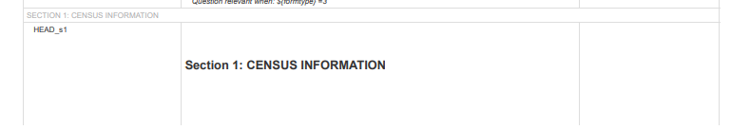
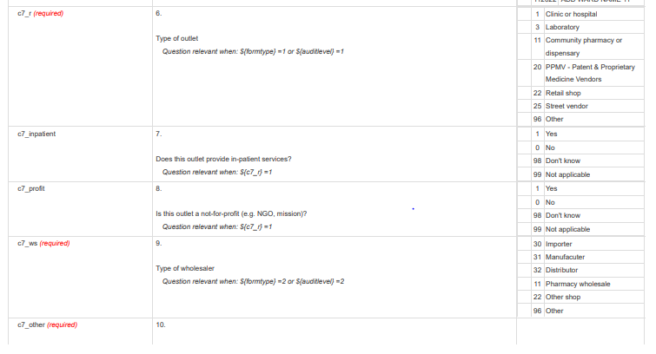
For all identified outlets:
Complete the first section of the questionnaire with census information (questions C1-C7)

Slide 61
Selection & consent
Introduce yourself and the point-of-sale study.
In short, why are you here?
Read the introductory text on the questionnaire / screen.
Evaluate the point of sale to find out if it meets the required conditions.
Does the outlet sell anti-malarial drugs or offer diagnostic tests for malaria?
If eligible, obtain consent.
Consent is verbal for participants in this study (consent signed by the fieldworker).
Ensure that procedures are properly compliant.
Start the interview.

Slide 62
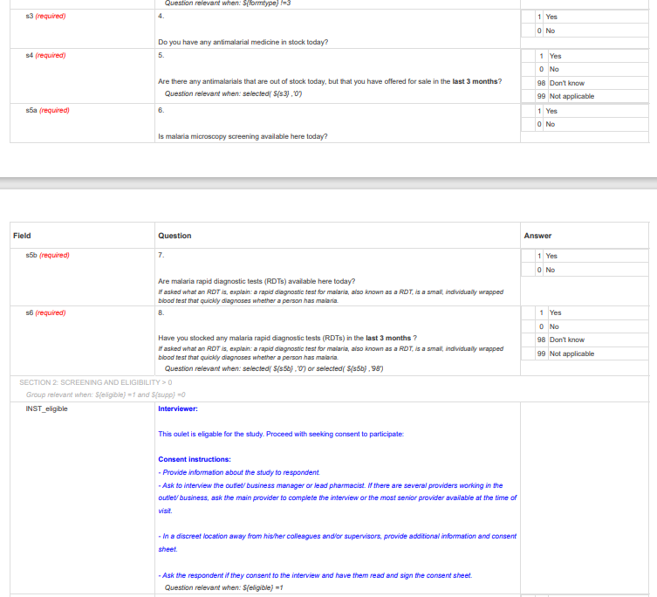
Is the Outlet eligible?
Introduce yourself and ask the screening questions
Eligible outlets will:
Have any antimalarial medicines on the date of interview
Report having had antimalarials in the past 3 months (i.e. stocked out today)
Have malaria blood testing on the day of interview
Report having blood testing in the past 3 months (i.e. stocked out today)

Slide 63
IF THE OUTLET IS ELIGIBLE:
Ask to speak to the main service provider.
Introduce yourself.
Ask if he/she is currently available for an interview.
If not, make an appointment to return.
Note date and time of questions C9, Result of visit and C11, Comments.
Providers may want an overview of the study.
Show the letter from the Ministry of Health, [your organization name] [your country], the letter of introduction from the local authorities.
Notes:
63

Slide 64
CONSENT

Slide 65
PROVIDING INFORMATION ON CONSENT
What is informed consent?
Agreeing to do something with a clear understanding of the facts, implications and future consequences.
Why is consent necessary?
Consent ensures that participants know the facts and agree to be interviewed. We cannot collect information without their permission.
Consent is a globally recognized ethical necessity. Any research related to health or medicine must be fully understood by the participants, who are then ready to take part, without any false hopes about why they want to do it.

Slide 66
CONSENT
It is possible that seeking written consent may lead participants, even from formal structures, to modify their behavior during the study because of the sensitivity of certain information, which could bias the data communicated by them. In order to avoid this type of behavior, we will collect verbal consent from participants.
Oral consent will be sought from all potential participants.
Note : The decision regarding written or oral consent varies by country. If the local IRB requires written consent, ACTwatch Lite will comply with this requirement. In such cases, the consent process will follow the written consent procedure.

Slide 67


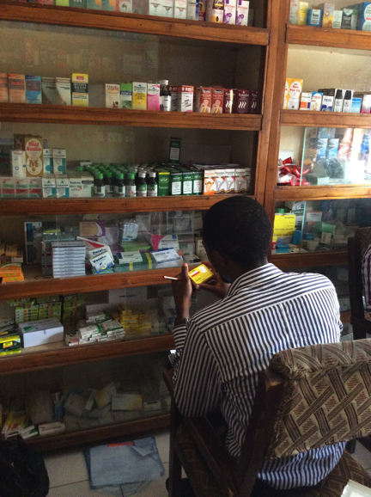
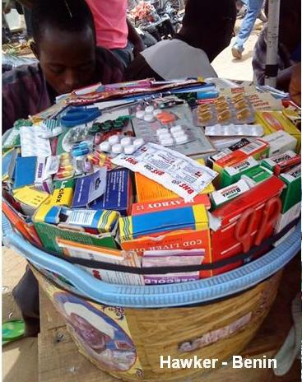
CONSENT
Oral consent will be sought, to avoid the risk of participants, even from formal structures, modifying their behavior
Training facilitators:
Please adapt this slide for your country. Add country-specific photos where possible

Slide 68
OBTAINING INFORMED CONSENT
Provide the information sheet to the potential participant, and be prepared to explain it verbally to them, and answer any questions the provider might have.
Briefly present the consent form to the provider.
If the provider/ their representative agrees to participate, keep the consent form, give an information sheet to the provider to keep.
Administer the questionnaire. SurveyCTO will generate a unique ID to be entered on the consent form.
Notes:
68

Slide 69
ORAL CONSENT
The respondent reads the text
Note facilitators: this verbal consent form is provided as an example from a previous ACTwatch Lite study. Please replace this screenshot with one relevant to your specific study.
The respondent ticks the box
Interviewer writes name, signs and dates

Slide 70
OVERCOMING OBSTACLES
What challenges do you foresee?
Providers could:
Be too busy
Be uncertain about participating
Not interested
Think that the information they give won't be useful
Think that the information they give will have repercussions on their business
How can we overcome these challenges?
Notes:
70

Slide 71
ACTwatch Lite [Country, Year]
Thank you for your attention!
Any questions?

Slide 72
4.5 Flow chart

Slide 73
TRAINER NOTES
Objective:
Help data collectors understand the correct order of steps during data collection - from identifying outlets to completing interviews and product audits.
Prompts & Answers:
What is the first step before visiting outlets? ➔ Review MoH lists, maps, and consult local leaders to identify all possible outlets.
After identifying an outlet, what to do next? ➔ Approach the outlet → collect census information (Section C1–C7)
When to ask screening questions? ➔ After census info is recorded, use screening to assess eligibility
When is consent obtained? ➔ Only if the outlet is eligible - then provide the info sheet and obtain oral consent
When to conduct product audits? ➔ After completing the provider interview - RDT and antimalarial audits come last

Slide 74
At the end of this presentation you should be able to:
Understand the flow of data collection
Notes:
74

Slide 75
Ask the provider if they can direct you to other outlets selling anti-malarial drugs.
Ask questions about rapid diagnostic tests.
Carry out the provider interview and drug audit.
Obtain consent.
Give clear information about the study to the main contractor.
Ask the selection questions to determine whether this outlet is eligible to answer the full questionnaire.
Complete the first section of the questionnaire (census information).
Identify and approach a point of sale (outlet) that may stock antimalarials or offer diagnostic testing services.
Review the list of outlets registered with [country’s National Malaria Control Program] and the Ministry of Health and any other information on outlet in district / municipality.
ACTIVITY
Get in groups of 4-5 people
Take the printout of the steps (shown to the right) and put them in the correct order

Slide 76
Step 1
Review the list of points of sale (outlet) registered with the MoH and [relevant regulatory authorities, if any], and any other information on outlets in the ward.
The list should be as exhaustive as possible.
The list should be completed by local authorities (regional/governmental leaders, health focal points, etc).

Slide 77
Step 2
Identify and approach a point of sale (outlet) that may stock antimalarials or offer diagnostic testing services
Snowball approach
Data collector’s own knowledge or contact
Notify field team supervisors if outlet not on list

Slide 78
Step 3
Complete the first section of the questionnaire (census information)
Now approach the outlet:
Step 4
Ask the selection questions to determine whether this outlet is eligible to answer the full questionnaire.
Step 5
Give clear information about the study to the main provider
Give the information sheet
Step 6
If eligible:
Obtain consent

Slide 79
Step 7
Carry out the provider interview, including wholesale and supply sections
Step 8
Ask the provider if they can direct you to other outlets selling anti-malarial drugs
Step 9
Ask questions about antimalarials → do audit
Step 10
Ask questions about rapid diagnostic tests → do audit
Step 11
Thank provider, end interview

Slide 80
4.6 Field logistics

Slide 81
TRAINER NOTES
Objective:
Prepare data collectors to organize daily fieldwork efficiently, manage movement across clusters, and ensure smooth coordination with supervisors and outlet providers.
Prompts & Answers:
What is the first step before going to the field? ➔ Confirm the daily outlet list, maps, and assignments with the a field team supervisor.
How do teams organize field visits? ➔ Teams are usually divided by ward/cluster, each with a field team supervisor. ➔ Assign transport, plan routes, and ensure tablets and consent materials are ready.
What if the provider is unavailable or the outlet is closed? ➔ Make two return visits before marking the outlet as “unavailable.” ➔ Leave a message or inform neighbors if appropriate.
How to report issues during fieldwork? ➔ Notify your field team supervisor immediately. ➔ Major issues (e.g., refusal, hostile provider, GPS errors) must be documented.

Slide 82
At the end of this presentation, you should be able to :
Understand the logistics and organization of field work.
Have a clear idea of the roles and responsibilities of everyone involved in the study.
Understanding quality control measures.

Slide 83
Fieldwork structure
Training facilitators:
Please insert information on the fieldwork structure (team composition, meetings/ debriefs, dispatch plans, etc.) here

Slide 84
Security of consent forms and follow-up sheets
They are valuable!!!
These are confidential documents.
You need to make sure you don't lose or damage them.
Interviewers must take care of questionnaires and consent forms with plastic bags (rain), folders, etc…
All data collectors are responsible for the documents they have had signed.
Training facilitators:
Please adapt this slide based on your specific study plans

Slide 85
Logistics and Communication
Telephone credits will be provided for communication.
Everyone should have the numbers of the entire research team, agency, and [your organization name] staff.
WhatsApp groups will be set up for: [External research agency] coordinators and [your organization name] staff, and then each state fieldwork team, [External research agency] staff and [your organization name] staff to aide communication, and allow for antimalarial product information to be fed between the teams
Training facilitators:
Please adapt this slide based on your specific study plans

Slide 86
Roles and responsibilities Who is involved in this study?
Example:
Field team :
Data collectors
Field team supervisors
Supervision and coordination :
Consultants
Supervisors
[Your organization name] team :
[Your organization name] team
ACTwatch Lite Core Team
Training facilitators:
Please adapt this slide based on your specific study plans

Slide 87
Role of the Interviewer
Conducting surveys
Report to field team supervisor
Contact the supervisor if you encounter any problems
E.g.: Census procedures or questions/doubts about how to complete the audit form
Responsibility for the tablet and accessories
Make sure you're ready for field work; all equipment complete, batteries charged
Keep a list of revisits and honor appointments with service providers
Ensure that study procedures are followed:
A complete census is carried out correctly
A consent form for each completed questionnaire
Questionnaires are well filled in
Training facilitators:
Please adapt this slide based on your specific study plans

Slide 88
Role of FIELD team SUPERVISORS: in collaboration with [Your organization name]
Ensure that all tools and materials are prepared:
Tablet and accessories, consent forms, follow-up sheets, information letters, letter of introduction (administrative and Min. Health), badges, pens and phone credit.
Transport/fuel.
Ensuring an adequate budget.
Communicate with [your organization name] staff about the situation in the field or any problems encountered.
Ensure data submission to [your organization name] staff through uploads to server.
Training facilitators:
Please adapt this slide based on your specific study plans

Slide 89
Role of FIELD Team SUPERVISORS: In the field
Introduce the team to the local authority on arrival in the area.
Draw up a schedule for each data collector: draw up a plan. Decide which route the data collector will take to cover the whole area in the time planned.
Plan for the timing of data collection to work with opening times/ less busy periods for outlets to ensure their participation.
Monitor fieldwork: Check with your data collector: is the interview done? the census conducted? Were there any problems in the field? Have all district boundaries been properly demarcated?
Training facilitators:
Please adapt this slide based on your specific study plans

Slide 90
Role of FIELD Team SUPERVISORS: In the field - SAFETY
You'll be in the field for several weeks while traveling to different locations in the work region.
A good field team supervisor needs to care about the health of his team members.
Safety is a priority!
You work in pairs to ensure each other's safety/security.
In the event of any misfortune (e.g. theft, hostility), report it directly to your field team supervisor as soon as possible.
In the event of theft, also report it to the police.
Ensure regular communication maintained between team members.
Training facilitators:
Please adapt this slide based on your specific study plans

Slide 91
Data quality control?
Quality control is a mechanism for ensuring that the result conforms to a pre-determined specification. Data QC will be carried out as and when required.
What does quality control mean for this study?
These are methods for ensuring that the final data are accurate and complete, and that procedures are correctly followed.
Training facilitators:
Please adapt this slide based on your specific study plans

Slide 92
Who are the data quality controllers for this study?
You!
Ensure data collectors do not falsify data.
Review the questionnaires to check that the number of outlets visited and the time recorded are consistent.
Confirm that the census has been well conducted and that the border has been well observed.
Random unannounced visits by [your organization name] supervisors, and external stakeholders.
Additional quality control will be carried out remotely on key information e.g.,
Checking progress
Checking GPS
Training facilitators:
Please adapt this slide based on your specific study plans
Study coordinators:
It is up to the research team to define QC/QA procedures for your study. Some guidance is provided in the ACTwatch Lite toolkit Manual and Implementation Guide; utilize best practices and team/ context appropriate approach

Slide 93
Penalties for MISCONDUCT
Misconduct: not conducting interviews properly or falsifying interviews.
Interviewers involved in misconduct will be removed from the study.
They will be required to pay all allowances and training costs relating to the study (transport, etc.).
Training facilitators:
Please adapt this slide based on your specific study plans

Slide 94
GROUP QUIZ: Who is responsible?
Fill in questionnaires
Ensure complete coverage of the selected health area
Conducting a quality control checks
Ensure proper storage consent forms
Take GPS coordinates of outlet
Identify the boundaries of the selected health area
Performing audits
Check completeness of questionnaires
Introducing the study to local authorities
Ensuring compliance with census procedures
Organize and direct daily activities
Notes:
94

Slide 95

ACTwatch Lite [Country, Year]
Thank you for your attention!
Any questions?

Slide 96
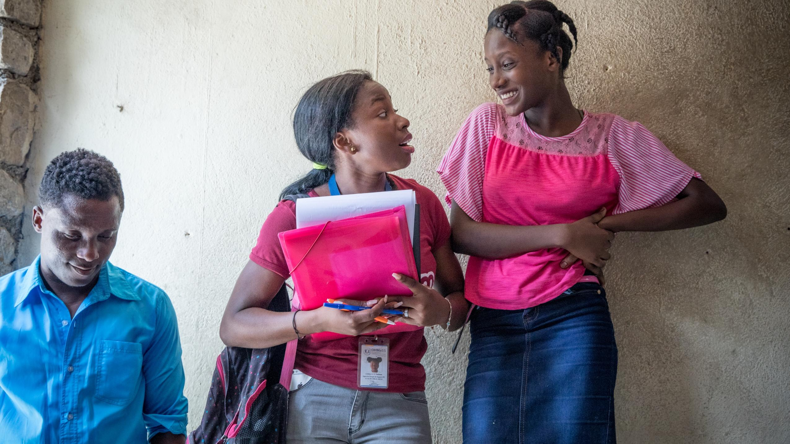
Annex

